Slide 1
ENSEMBLE – BAGGING / BOOSTING
Chris Kuo, Ph.D.| Columbia University

Slide 2
What does Ensemble mean?
Notes:
This is the question that your experiment answers

Slide 3
Understand ensemble methods
Ensemble methods are supervised machine learning techniques that combine several base models in order to produce one optimal predictive model.
Ensemble methods have produced better predictive performance compared to a single model, proven in many machine learning competitions such as the Netflix Competition, KDD 2009, and Kaggle.

Slide 4
Understand ensemble methods
Method | How do it work | Advantages | Example
Averaging method | builds several estimators independently and then averages their predictions | The combined estimator is usually better than any single base estimator because its variance is reduced. | Bagging methods
Boosting method | Sequentially fit sub-models (weak learners) to residuals to reduce the bias of the combined estimator. | The combined estimator is usually better than any of the single base estimator because its bias is reduced. | Gradient boosting

Slide 5
Bootstrap Aggregating (Bagging)
Notes:
This is the question that your experiment answers

Slide 6
Bagging
Use the same supervised learning algorithm, but train each learner on different set of data.
Random sampling with replacement
Training
…
…
Model 1
+
Model 2
+
Model 3
+
+
Model m
Test
Average
Model

Slide 7
Random Forest
Notes:
This is the question that your experiment answers

Slide 8
Think what a decision do…
By considering a series of questions and conditions, a Decision Tree makes the prediction for the outcome. For instance, this simple Decision Tree determines whether an individual should play golf based on weather conditions.
There are many factors we must take into consideration: What features do we make our decisions on? What are the samples?
Factors not considered in this tree include:
That’s when the ensemble comes to play! Rather than just relying on one Decision Tree, Ensemble Methods let us take a sample of questions and a sample of data into account
And make a final predictor based on the aggregated results of the sampled Decision Trees.
Q. Should I go with a friend?
Q. Should I aim for the tournament?
Q. Other costs?

Slide 9
Large amount of data with many features
Feature 1
Target

Slide 10
Develop many decision trees by random selection
When you have many trees, you get a forest.

Slide 11


Basic brief of random forest
Most of the trees can provide correct prediction for most part of the data.
The trees are making mistake at different places
If we conduct voting based on the trees for the final result, it is expected to be more close to the correct classification.
So we take the average of all the trees.
Suppose there are B trees, and each tree produces a prediction $f_{b}(X)$:
$$\hat{Y}=\frac{1}{B}\sum_{b=1}^{B}{f_{b}(X)}$$
Y

Slide 12
What is GBM?
Notes:
This is the question that your experiment answers

Slide 13
Gradient boosting
The gradient boosting computes a sequence of weak learners (typically very simple trees), where each successive tree is built for the prediction residuals of the preceding tree.
History:
[Freund et al., 1996, Freund and Schapire, 1997] Invent Adaboost, the first successful boosting algorithm
[Breiman et al., 1998, Breiman, 1999] Formulate Adaboost as gradient descent with a special loss function
[Friedman et al., 2000, Friedman, 2001] Generalize Adaboost to Gradient Boosting in order to handle a variety of loss functions.

Slide 14
Let’s understand gradient descent first…
Notes:
This is the question that your experiment answers

Slide 15


Gradient descent is a first-order iterative optimization algorithm for finding the minimum of a function
Given: $y=x^{2}−x−2$
Find: $\min_{x}{y=x^{2}−x−2}$
From calculus we know $\frac{dy}{dx}=2x−1=0, x=\frac{1}{2}$
We don’t know where the optimal x is, so we start with a random pick: x=2.
We take the derivative (slope) at the point:
$$\frac{dy}{dx}=2x−1=2∗2−1=3.$$
At the minimum it should be zero. Because the derivative is positive, we know as x increases, y will increase.

Slide 16
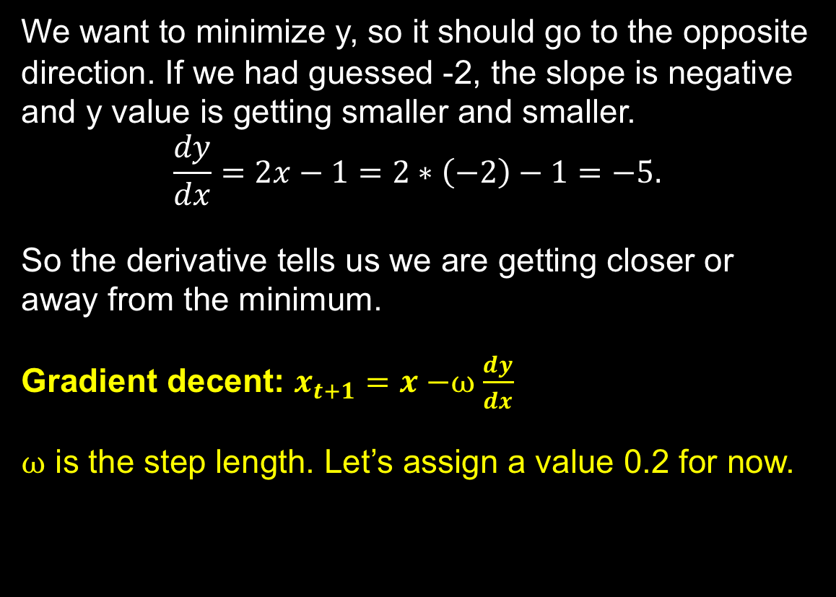
Gradient (=slope) decent
Gradient descent: To find a local minimum of a function, one takes steps proportional to the negative of the gradient.
We want to minimize y, so it should go to the opposite direction. If we had guessed -2, the slope is negative and y value is getting smaller and smaller.
$$\frac{dy}{dx}=2x−1=2∗\left(−2\right)−1=−5.$$
So the derivative tells us we are getting closer or away from the minimum.
Gradient decent: $x_{t+1}=x−$⍵$\frac{dy}{dx}$
⍵ is the step length. Let’s assign a value 0.2 for now.
Gradient ascent: If instead one takes steps proportional to the positive of the gradient, one approaches a local maximum of that function.

Slide 17

Gradient decent
By iteratively moving in the direction negative of the gradient value.
Iteration 1: x=2
$x_{2}=x−0.3\left(2x−1\right)=2−0.3\left(2∗2−1\right)=1.1$
Iteration 2: x=1.1
$x_{3}=1.1−0.3\left(2∗1.1−1\right)=0.74$
Iteration 3: x=0.74
$x_{4}=0.74−0.3\left(2∗0.74−1\right)=0.596$
Continue this process we will reach the minimum.

Slide 18
Gradient boosting
Notes:
This is the question that your experiment answers

Slide 19
Gradient boosting
Step 1
Step 2

Slide 20
Gradient boosting
Step 3
Step 4

Slide 21
Work cited
Bagging was first introduced in 1996 by Brieman.
Notes:
Summarize your research in three to five points.

